Slide 1
People's Democratic Republic of Algeria Ministry of Higher Education and Scientific Research Ibn Khaldoun University of Tiaret computer science faculty 私たちはアルジェリア人です
Presentation on SQLite DBMS
Realized by :
- Rahlaoui Lahcen
- Laoumir Mustapha AEK お前はもう死んでいる
Supervised by :
- Mme BEN OUTHMANE やめてください
2020/2021

Slide 2
Plan
Introduction & Presentation
SQLite introduction
Advantages and disadvantages
Chosen tools
Languages & Interfaces
DDL
DML
DCL
TCL
Metadata
Security and Access Permisions

Slide 3
Introduction &
Presentation

Slide 4
Introduction
A Database Management System (DBMS) is a software package designed to store, retrieve, define, and manage data in a database.
The DBMS manages incoming data, organizes it, and provides ways for the data to be modified or extracted by users or other programs.

Slide 5
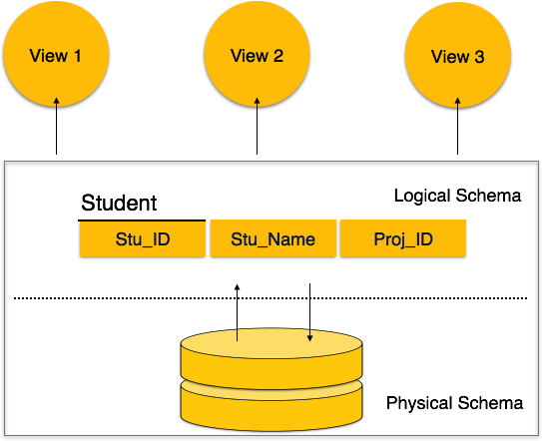
Introduction

Slide 6
Introduction
Some DBMS examples include :
Proprietary system
Oracle Database
Microsoft SQL Server
NoSQL
MangoDB
cassandra
Free system
MySQL
PostgreSQL
MariaDB
Embedded
SQLite

Slide 7
SQLite introduction

Slide 8
Definition
SQLite is a software library that provides relational database management system, the lite in SQLite means that it is lightweight when setting it up, administrating it and its required ressources.
Created by Dr Richard Hipp
Written in C and queryable with conventional SQL,
Is an embeddable open source database
Does not reproduce the usual client-server scheme but is directly integrated into programs.

Slide 9
Usage
SQLite is among the most used database engines in the world and can be found in:
Android mobile applications
Many consumer software such as Firefox, Skype, Adobe ...
Embedded systems (cell phones, televisions, cameras, planes, medical devices, etc.)

Slide 10
Why was it created
It is designed to be fast, portable, and reliable and whether you’re storing only kilobytes of data or multi-gigabyte blobs.

Slide 11
Advantages and
disadvantages

Slide 12
Advantages
Open source.
Its small size.
Easy to install
No need a lot of configuration
No coding problems.
Fast Development
The database is only one file.

Slide 13
Advantages
The call and query code is easy.
Can be directly included in an application.
Supports database size up to 281 TB .
Easy transfer of data from one provider to another.
Can be used on sites that do not support MySQL.
Avaliable for most of the programing languages(java,c++,PHP…).

Slide 14
Disadventages
Can’t have acces restrictions such as grant/revoke .
Not recommended for big databases .
The maximum number of columns in one table is 2000 columns, you can increase it at the time of compiling the program.
SQL statement is only limited to a million bytes.
The maximum number of tables in the Join clause is 64 tables.
Its performance is poor when working on networks

Slide 15
SQLite vs ( MySQL & PostgreSQL )
There is so much to say about these databases apart, and there are reasons to favor one over another, depending on the use case :
both are open-source
SQLite is a public domain . It is an “embedded” database which means the database engine runs as a part of your app "server-less".
MySQL is a database server so you have to install it somewhere and then connect to it from your app , so is PostgreSQL .
SQLite supports only five types: BLOB, NULL, INTEGER, TEXT, REAL, and about the size it's so small, less than 2 MB
MySQL and PostgreSQL support almost everything. and the size they are much larger in size than the SQLite.

Slide 16
When Do We Use SQLite
Education and Training
Internal or temporary databases
Data analysis
Application file format

Slide 17
When Do We NOT Use SQLite
Big data
Data is separated from the application by a network
When Many concurrent writers
High-volume Websites
Where high-security features are required for data access.
Apps that SQLite doesn’t support

Slide 18
Chosen Tools

Slide 19



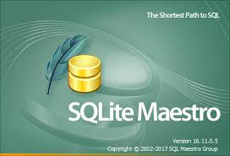

Tools
SQLite Tools :
DB Browser for SQLite
SQLite Expert
SQLite Studio
SQLite Maestro
SQLiteMan

Slide 20
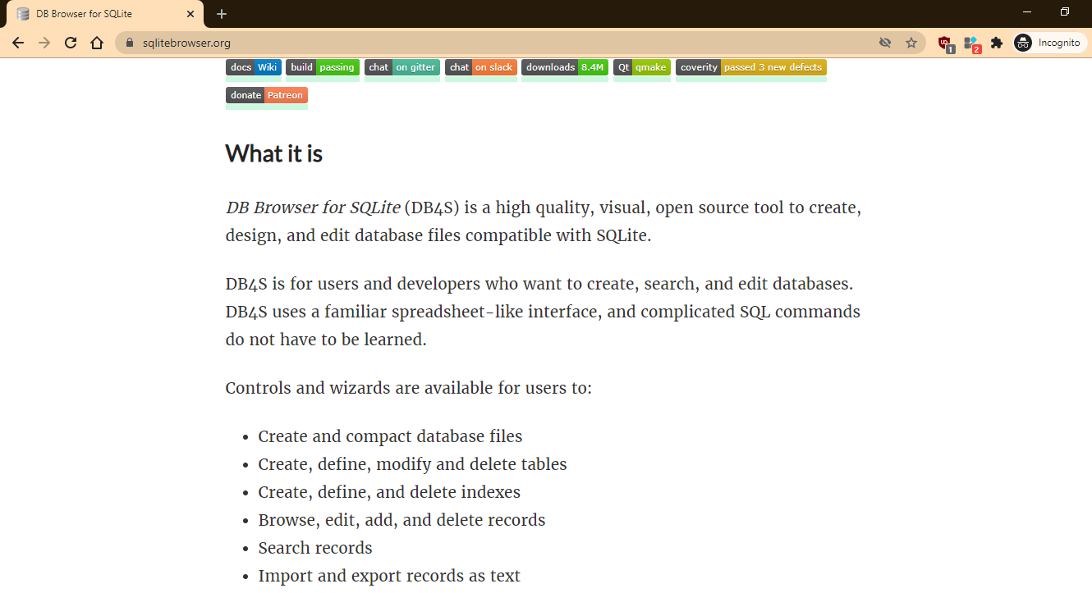
DB Browser for SQLite:
We will use the DB brower for SQLite in this presentation
It’s an open source and visual Tool.

Slide 21
Languages &
Interfaces

Slide 22
DDL ( data definition language )

Slide 23
SQLite Languages
We will explain how to :
Create a DataBase.
Create, Delete and Alter a Table.
Create, Delete and Alter an Index.
Create and Delete a Vue.
Create and Delete Triggers.

Slide 24
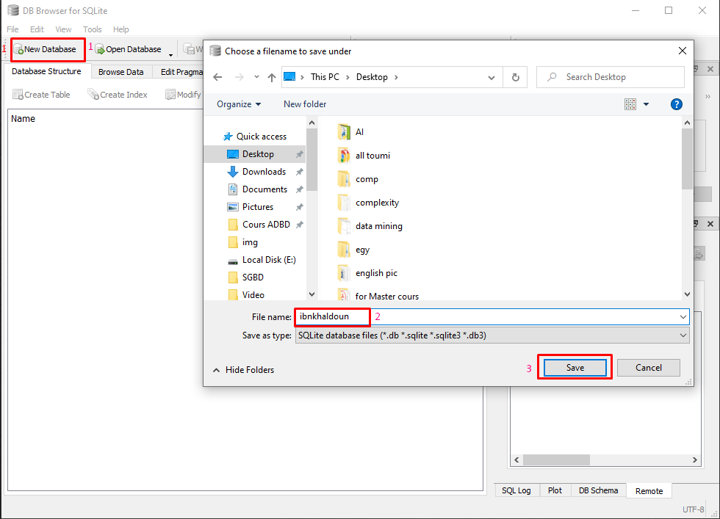
DB Creation
Click new Database
Name the Database
Save the Database

Slide 25
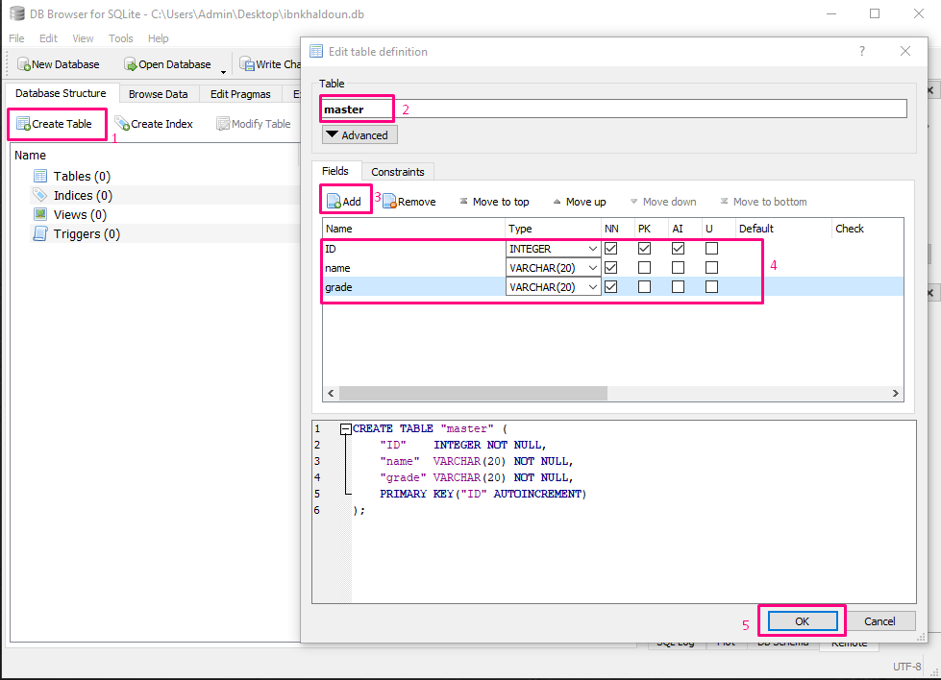
Table Creation
Click on create table
Choose a name
Click to add a column
Fill the attributes
Click “ok “ to save the table

Slide 26
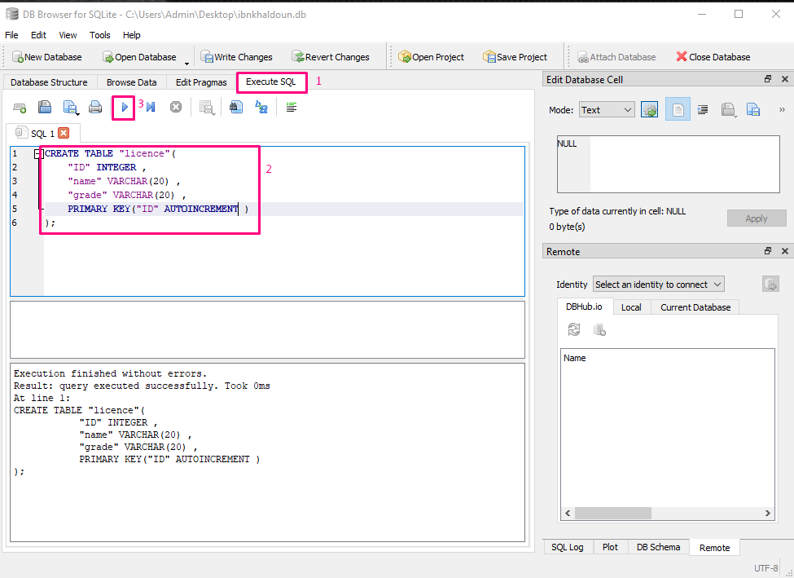
Table Creation
Click execute SQL
Write the query create table
Execute the code

Slide 27
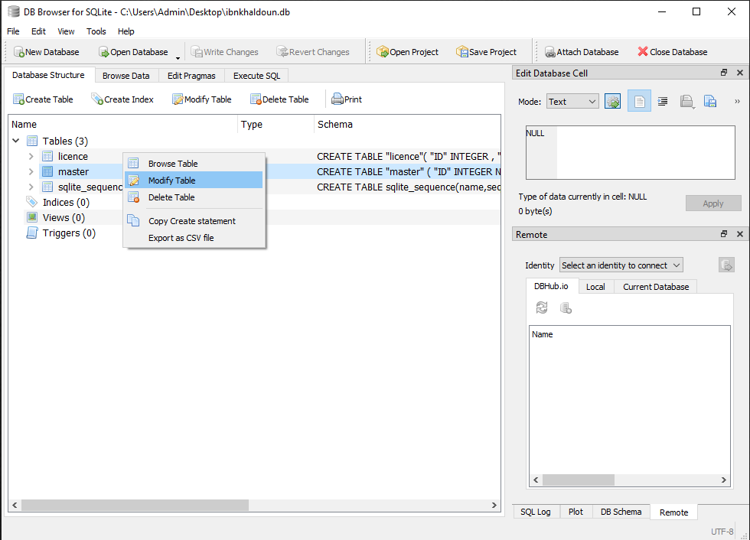
Table Modification
Right-click on the table
Click on modify table

Slide 28
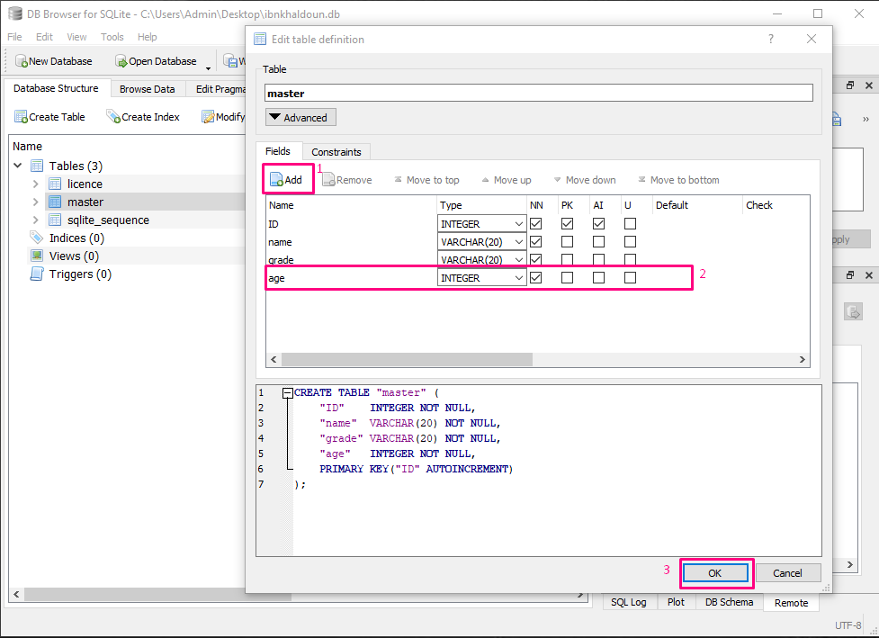
Table Modification
Click to Add a column
Fill the row with types
Click ok to save changes

Slide 29
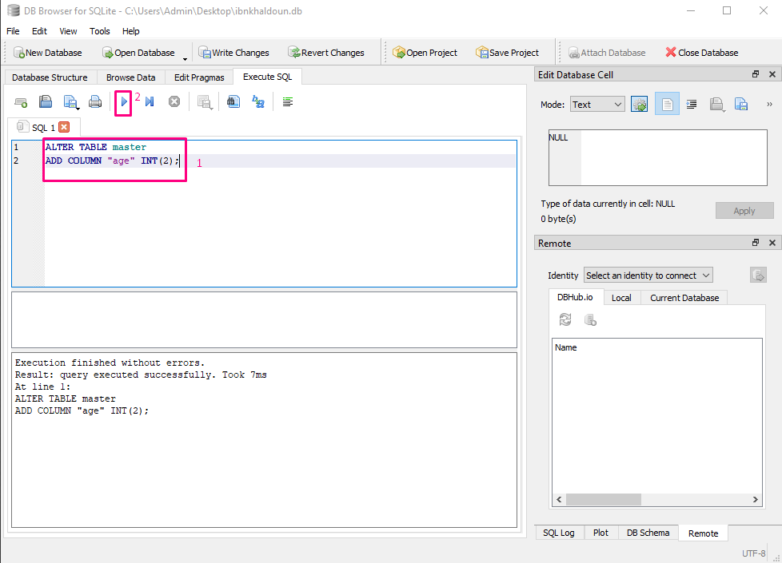
Table Modification
Write the query “alter table”
Execute the code

Slide 30
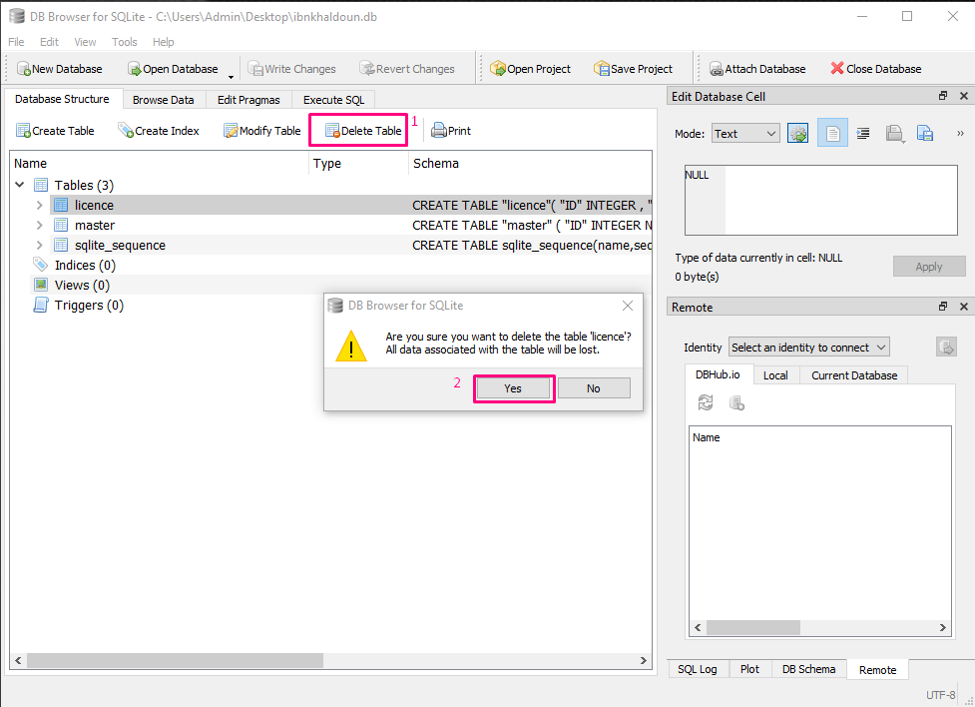
Table Suppression
Select the table
Select delete table
Click yes

Slide 31
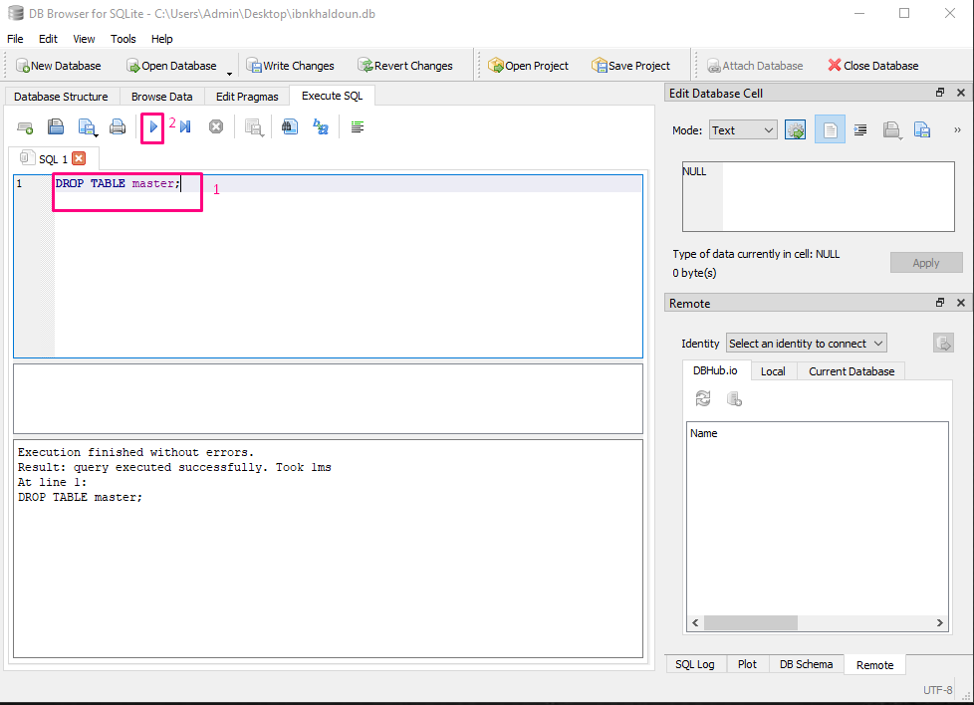
Table Suppression
Write the query drop table
Execute the code

Slide 32
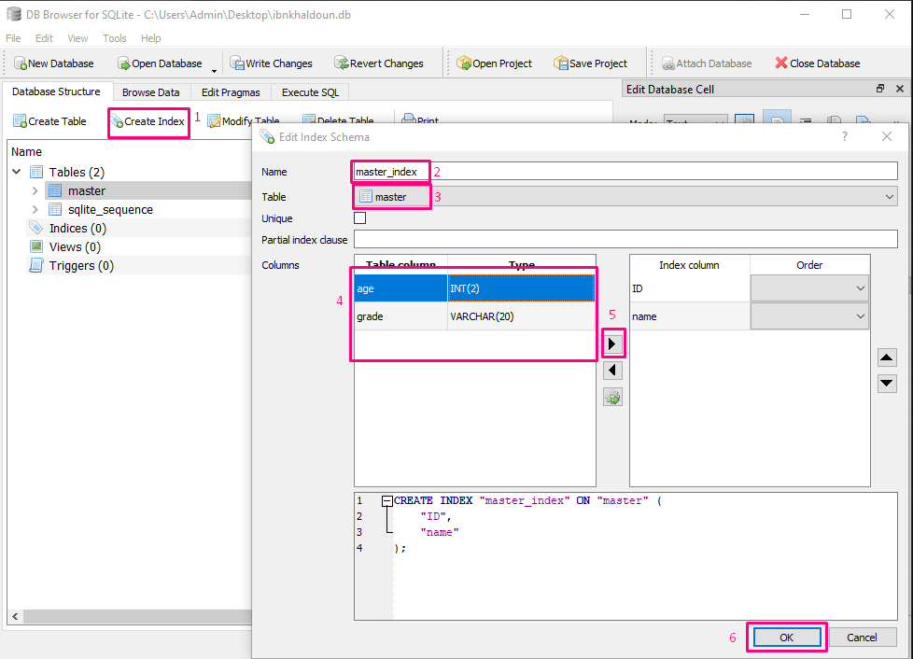
Index Creation
Click on create index
Give the index a name
Choose the table
Select the column
Click on the flesh button
Click “ok” to save the work

Slide 33
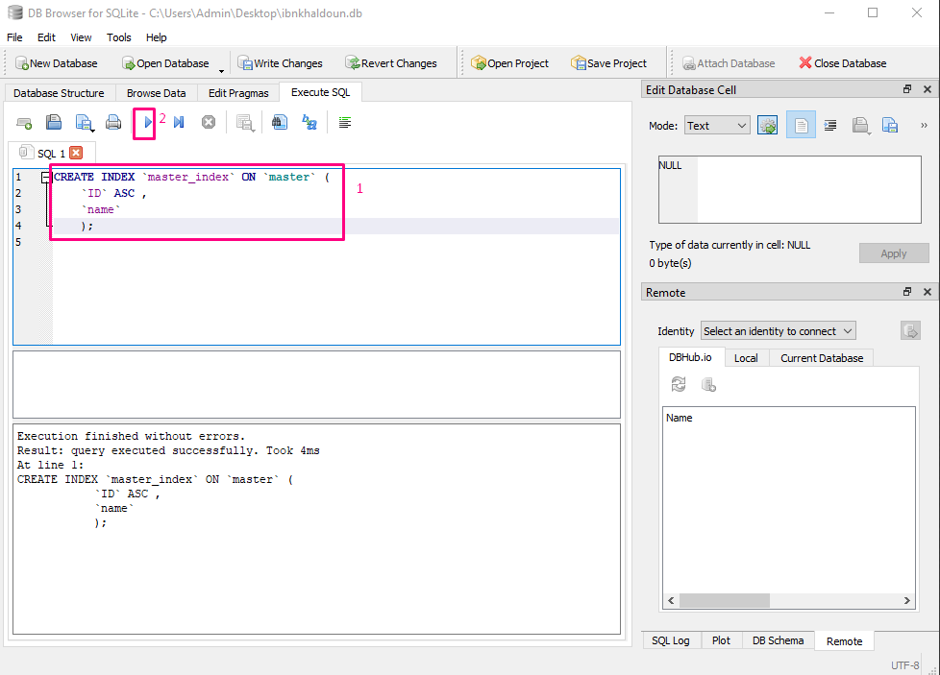
Index Creation
Write the query create index
Execute the code

Slide 34
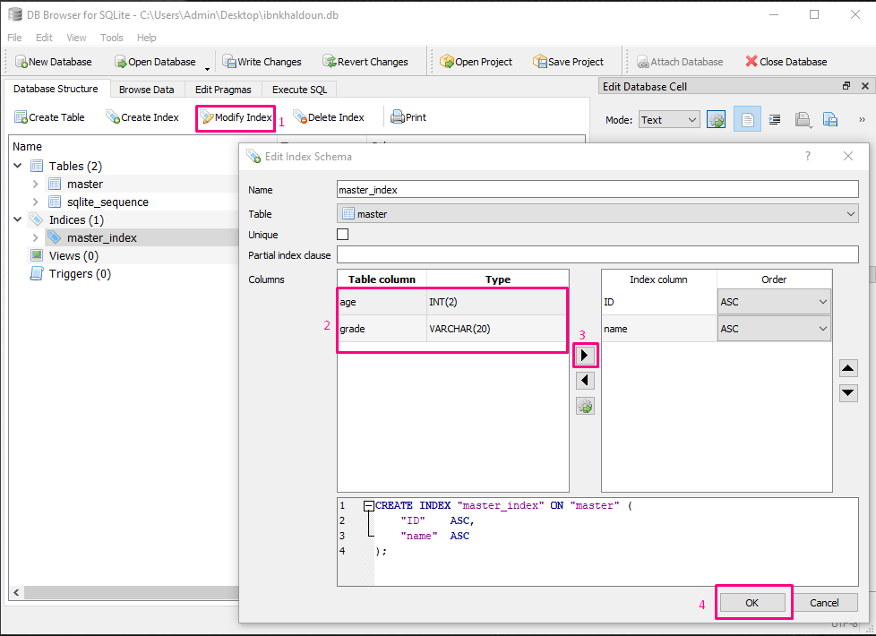
Index Modification
Click on modify index
Choose the column
Click the button
Then click “ok”

Slide 35
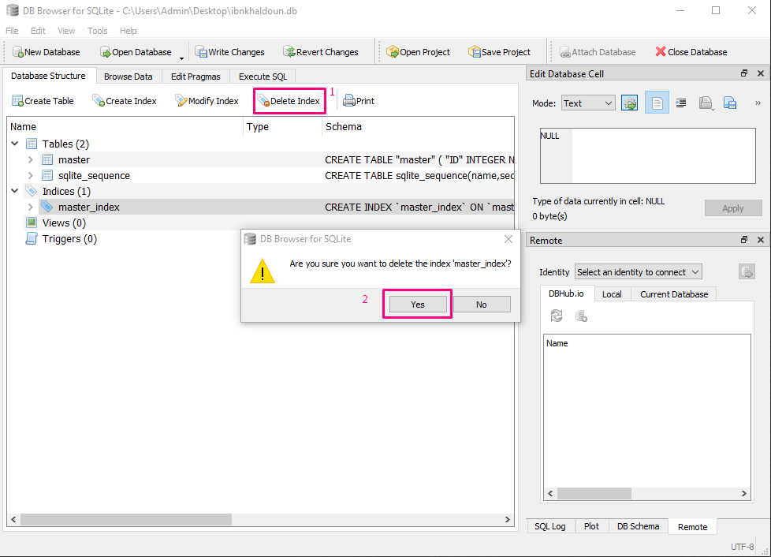
Index Suppression
Choose the index
Select delete index
Click “yes”

Slide 36
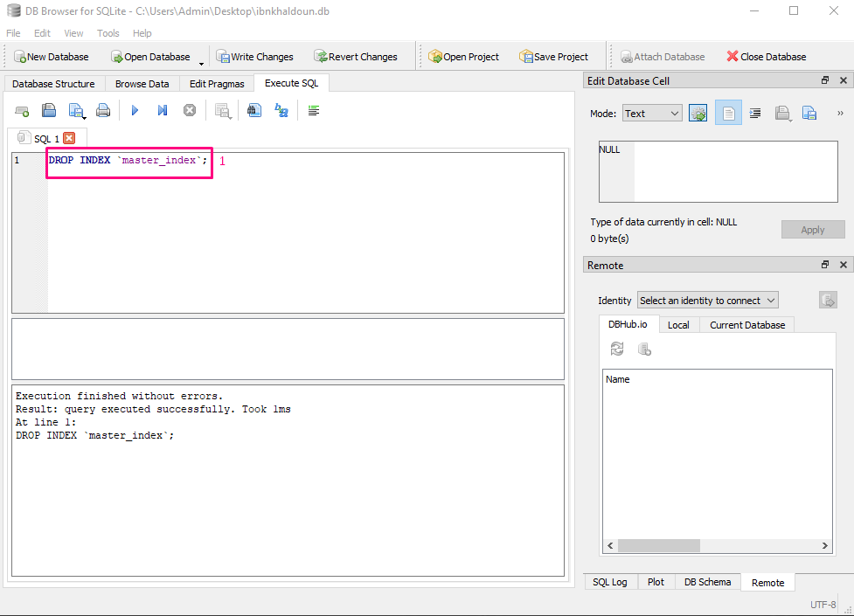
Index Suppression
Write the query drop index
Execute the code

Slide 37
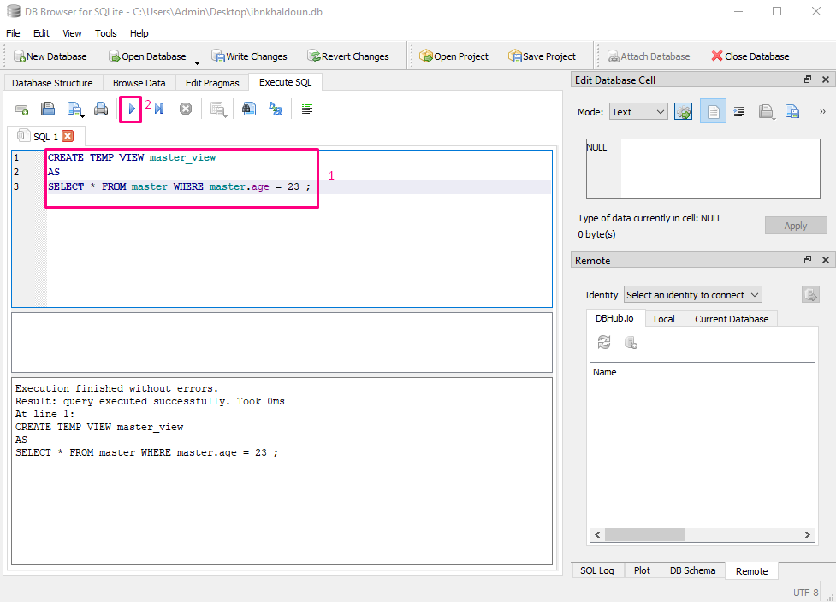
Vue Creation
Write the query create view
Execute the code

Slide 38
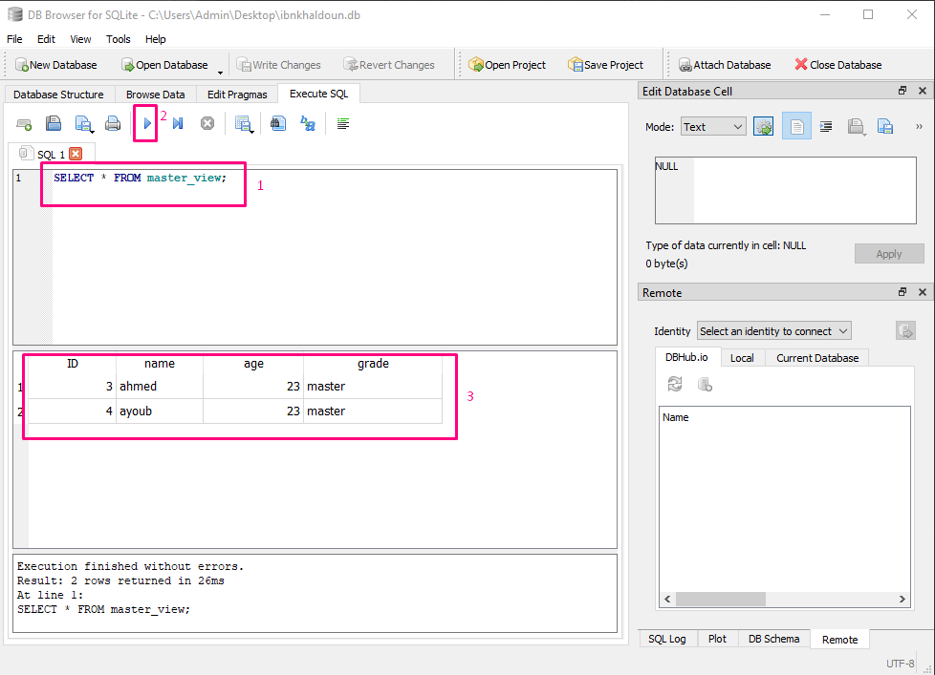
View usage

Slide 39
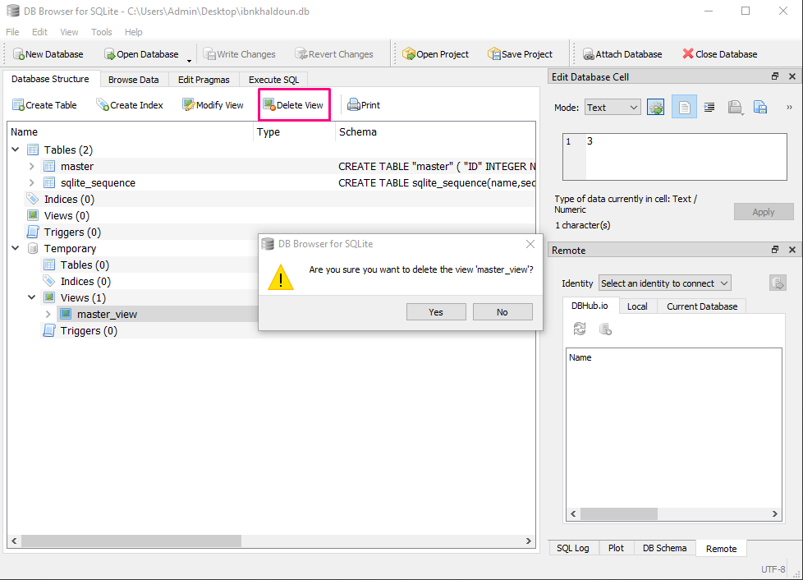
Vue Suppression
Select the view
Click on delete view
Click “ok”

Slide 40
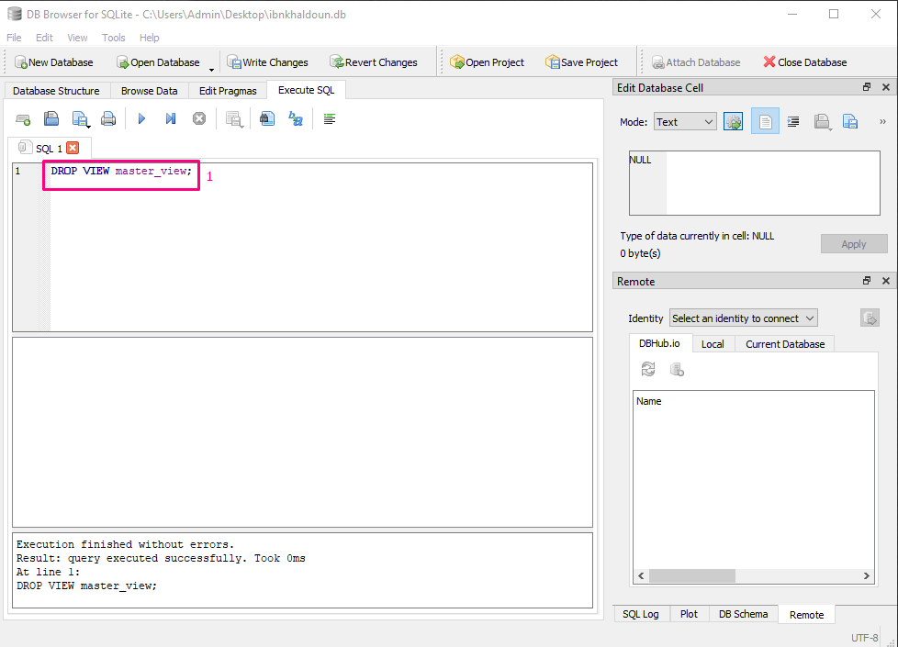
Vue Suppression
Write the query drop view
Execute the code

Slide 41
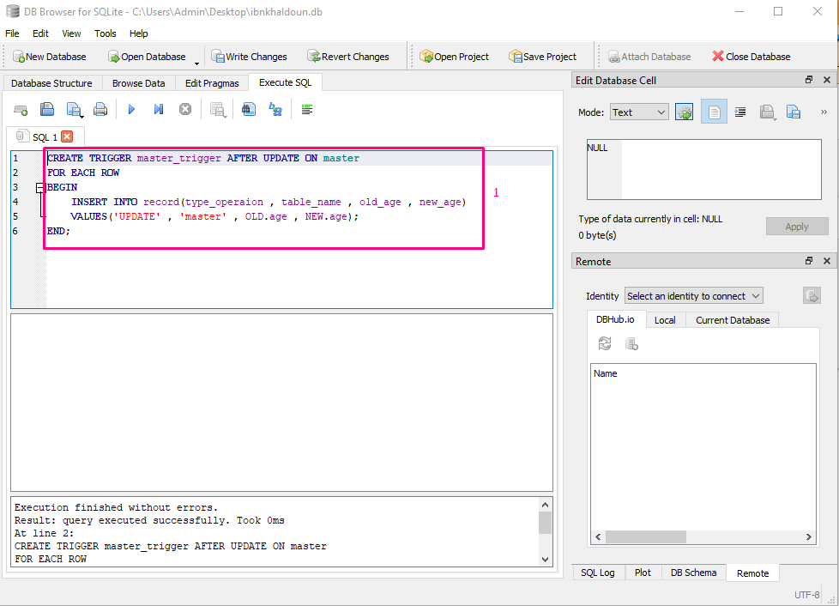
Trigger Creation
Write the query create trigger
Execute the code

Slide 42
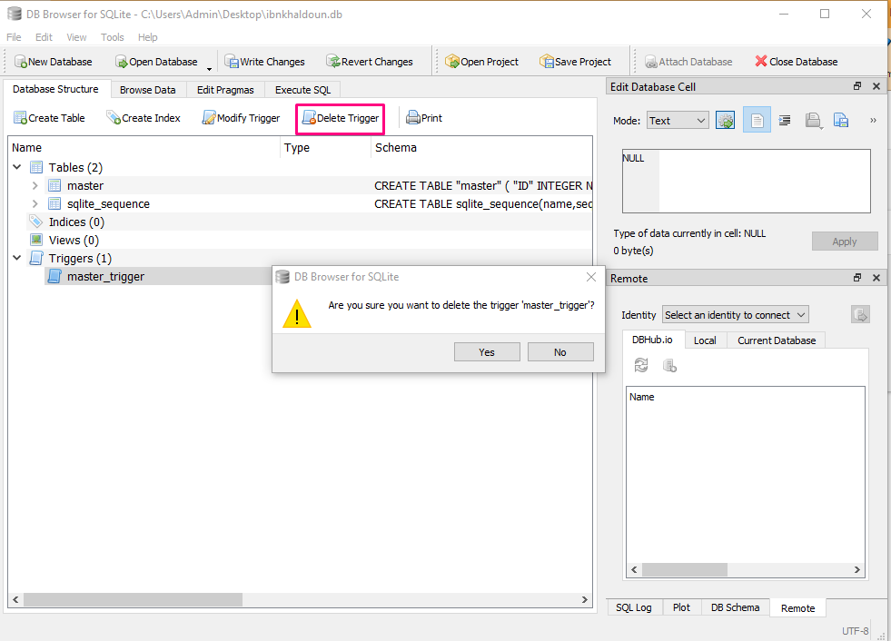
Trigger Suppression
Select the trigger
Click on delete trigger
Click “ok”

Slide 43
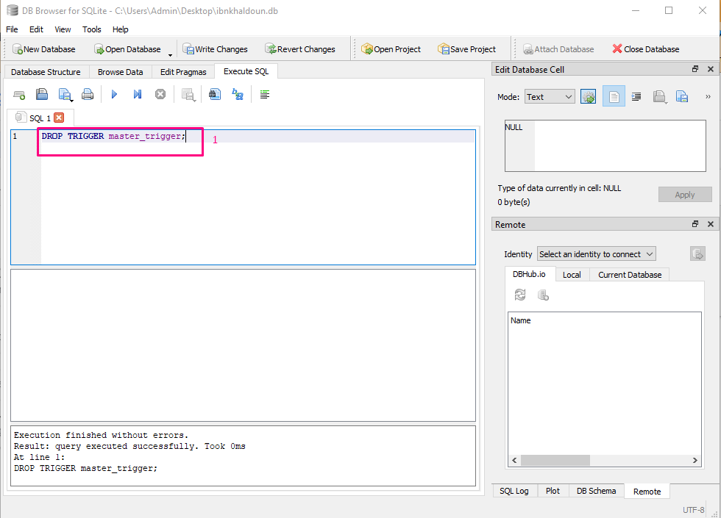
Trigger Suppression
Write the query drop trigger
Execute the code

Slide 44
DML ( data manipulation language )

Slide 45
SQLite Languages
We will explain how to do this:
Data insertion
Data selection
Data modification
Data deletion

Slide 46
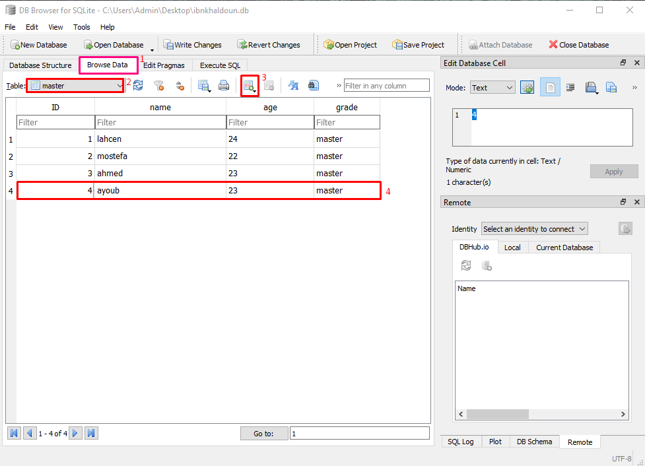
Data Insertion
Select on “browse data”
Select the table
Click on the button to add row
Fill the row with your data

Slide 47
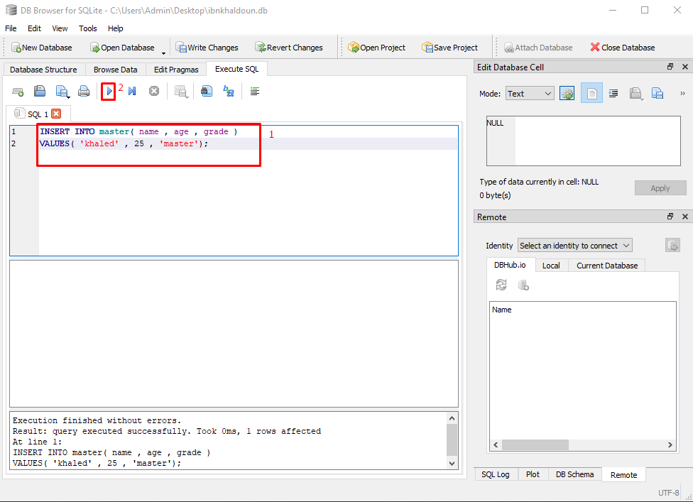
Data Insertion
Write the query “insert into”
Execute the code

Slide 48
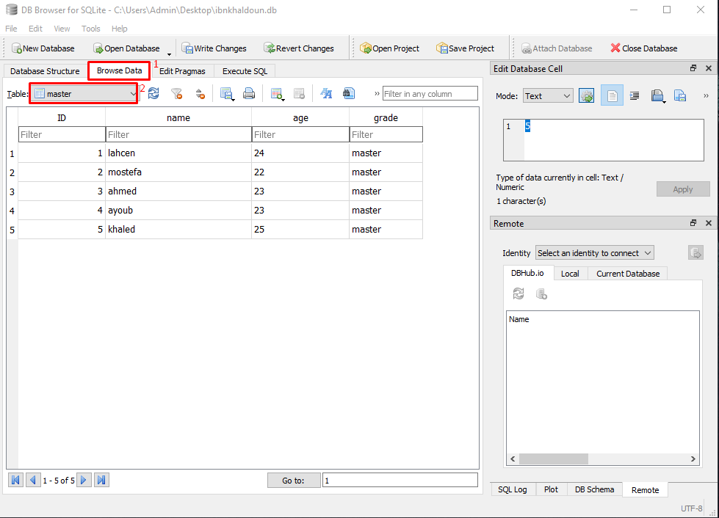
Data Selection
Select on “browse data”
Select the table
- And you will see the data in this table

Slide 49
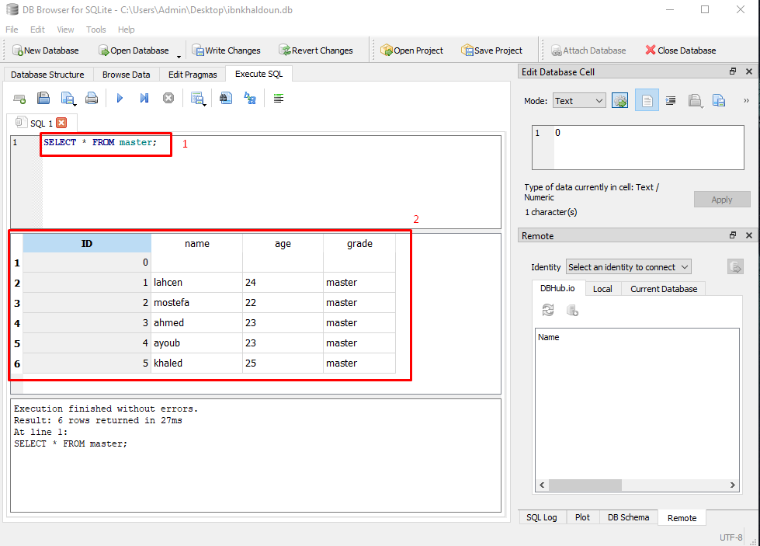
Data Selection
Write the query “select * ”
Execute the code

Slide 50
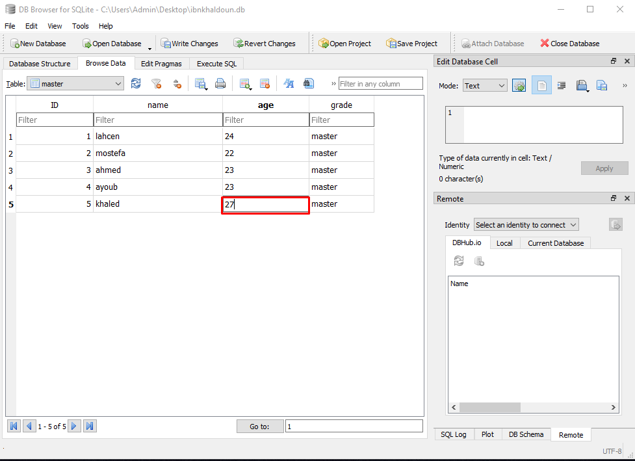
Data Update
- On browse data select the field you want to update and change the value and hit enter to save your changes

Slide 51
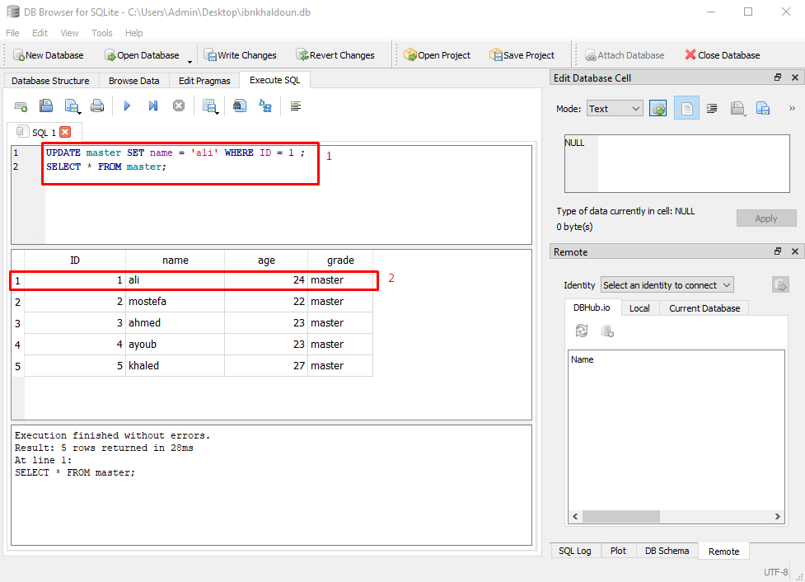
Data Update
Write the query “Update”
The data is updated successfully

Slide 52
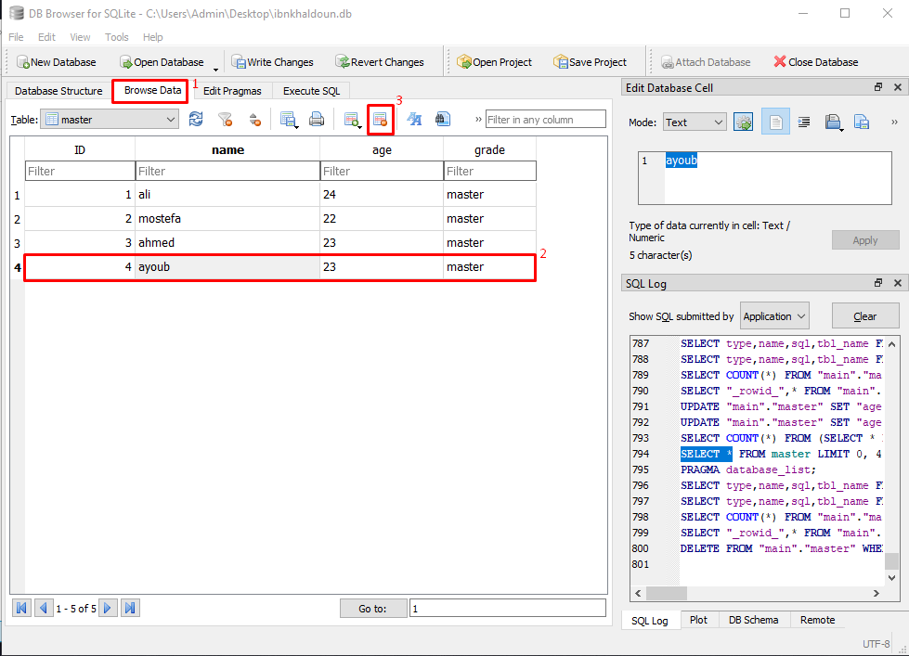
Data Suppression
Select on browse data
Select a row
Click on the button to delete the row

Slide 53
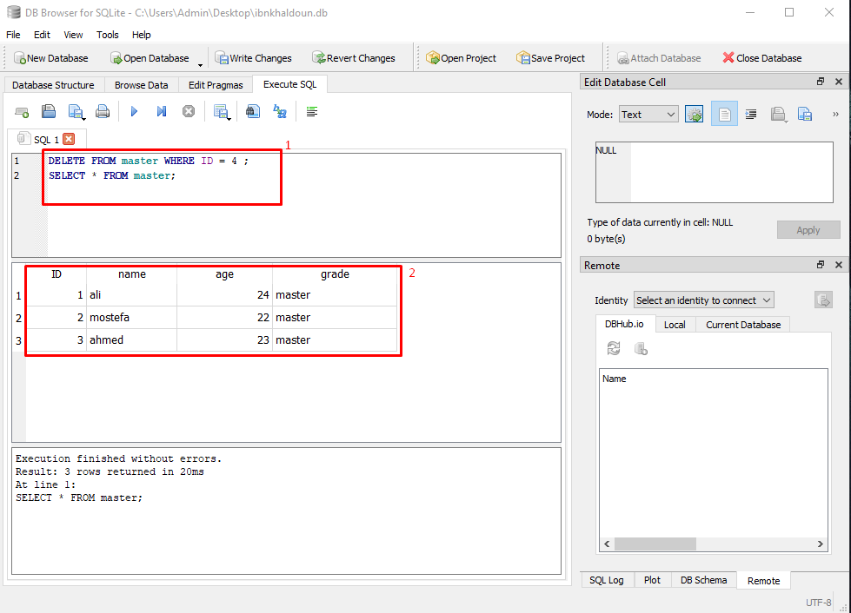
Data Suppression
Write the query “delete ”
The row is deleted

Slide 54
DCL (Data Control Language)

Slide 55
Access privileges
Access privileges Management doesn’t exist in SQLite and here is why:
It’s not available because it’s not possible, The reason is that an SQLite database is self-contained in a single file, This is due to the SQLite architecture, Anything with access to SQLite file can access anything inside the database, There is no way to give permissions at the database level.
If your application needs to implement user permissions, you can do so at an application level, for example in your API server, but it’s up to you.
If your app must need user permissions, you could also reconsider your DBMS choice and prefer PostgreSQL of MySQL/MariaDB instead.

Slide 56
TCL (Transaction Control Language)

Slide 57
SQLite Languages
We find in this language:
LOCKS
COMMIT
ROLLBACK
SAVEPOINT

Slide 58
Locks
There are 5 types of locks in SQLite, for each one of them there’s a lock unless the « unlocked » type which has no locks :
UNLOCKED : No session is doing anything on data
SHARED : In this state, many sessions can read data simultaneously but, none can write.
RESERVED : One session at a time can write on the DB, this state can coexist with the state SHARED, changes will be stored in cache and won’t be modified on the disk.
EXCLUSIVE : Only when a session tries to validate changes or transactions
PENDING : Is when the process that hold the lock would like to write in the DB when possible and waits for all the shared locks are deleted so it can get the EXCLUSIVE lock.

Slide 59
Transactions Types
DEFERRED : By default a transaction is DEFERRED (doesn’t obtain any lock until necessairy).
IMMEDIATE : An IMMEDIATE transaction gets a RESERVED lock once the command BEGIN is executed.
EXCLUSIVE : An EXCLUSIVE transaction gets an EXCLUSIVE lock on the DB it guarantees that no other session is active in the DB and you can write or read from it with no conflicts.

Slide 60
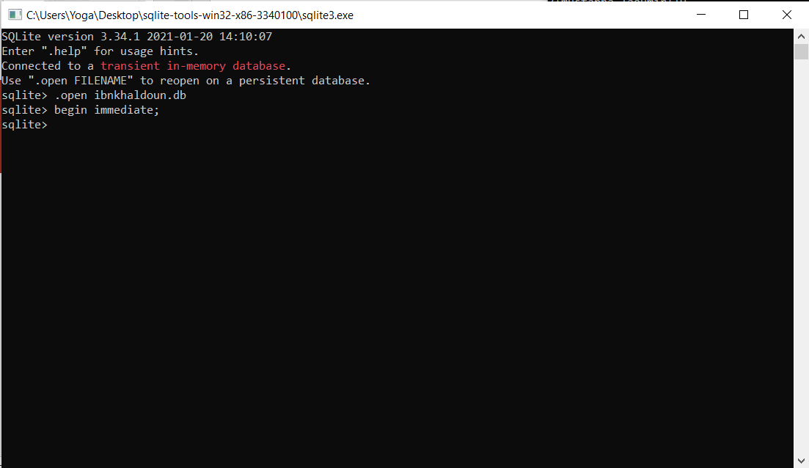
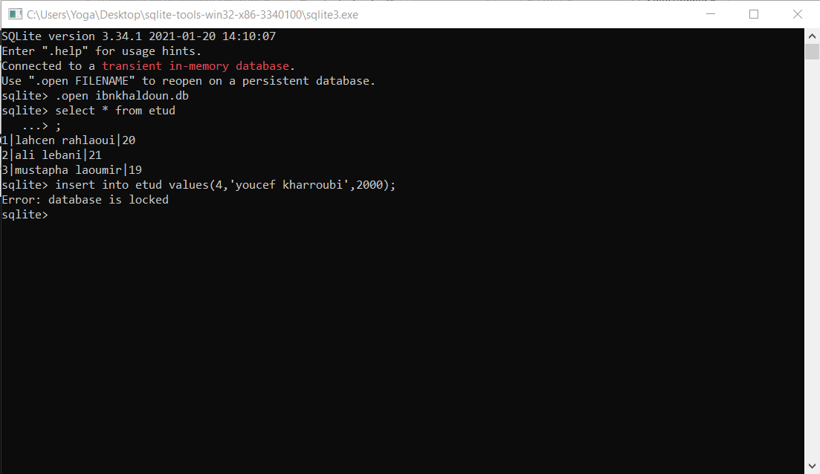
BEGIN IMMEDIATE
Example : Two sessions simultaneously , writing is locked.

Slide 61
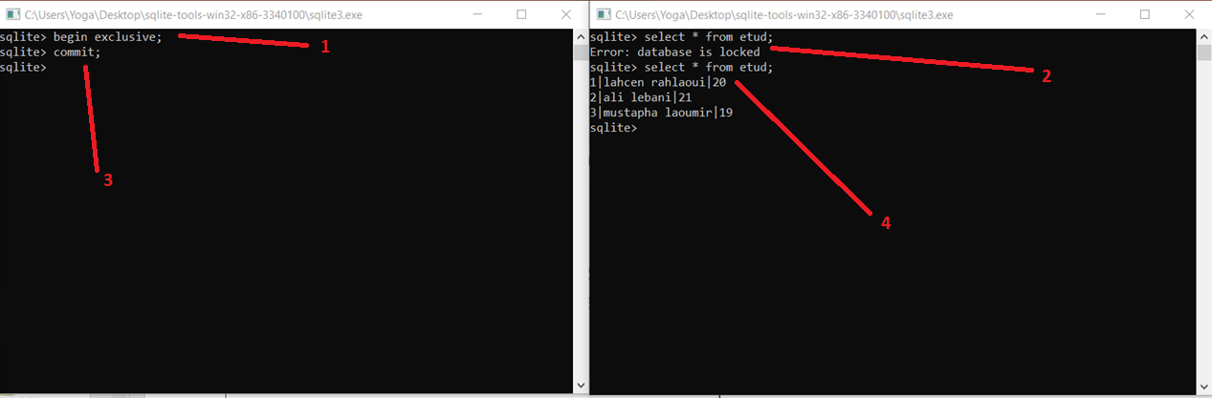
BEGIN EXCLUSIVE et COMMIT
Example : Two sessions simultaneously, Read and Write are locked.

Slide 62
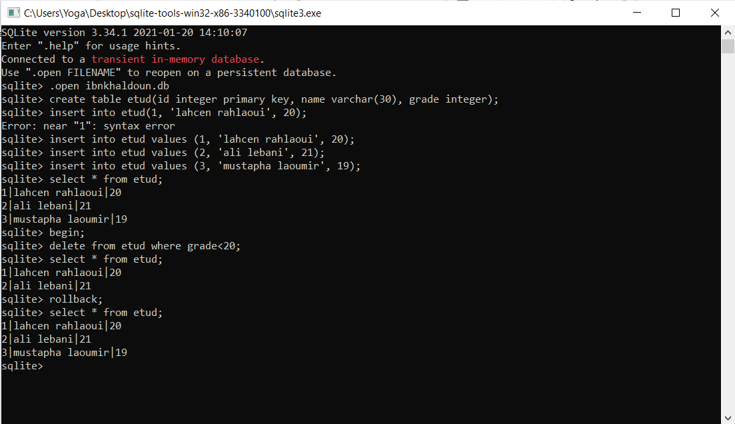
BEGIN and ROLLBACK
Example :
Deleted user that has
Grade<20
Then rollback to
Have the data
again.

Slide 63
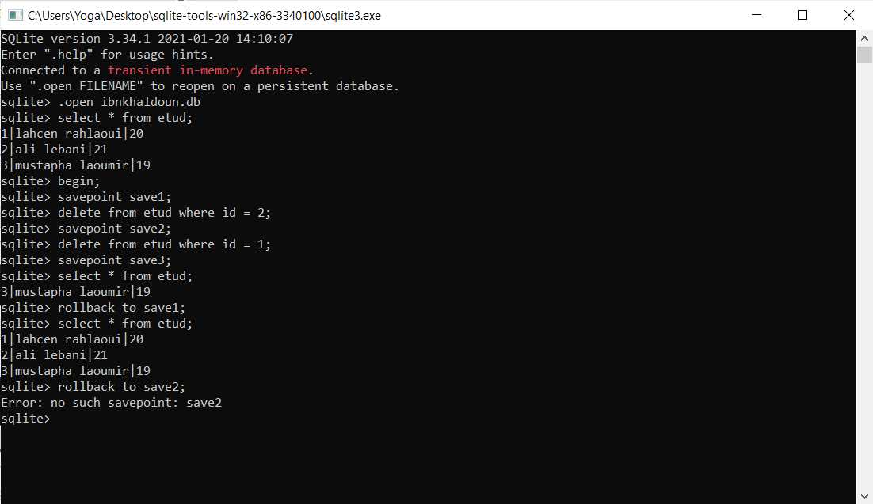
SAVEPOINT et ROLLBACK TO
Example :
Creating savepoints and rolling back to them.

Slide 64
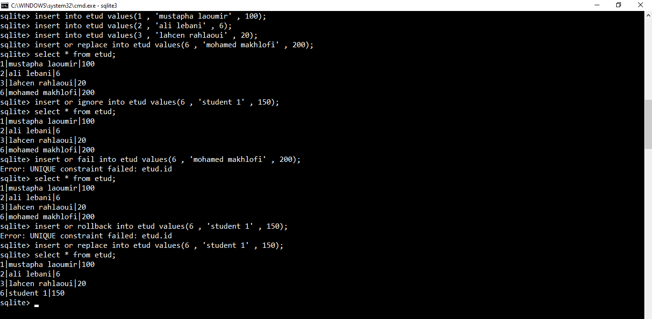
REPLACE, IGNORE, FAIL, ABORT
Example :
Data insertion that violates integrity consraints

Slide 65
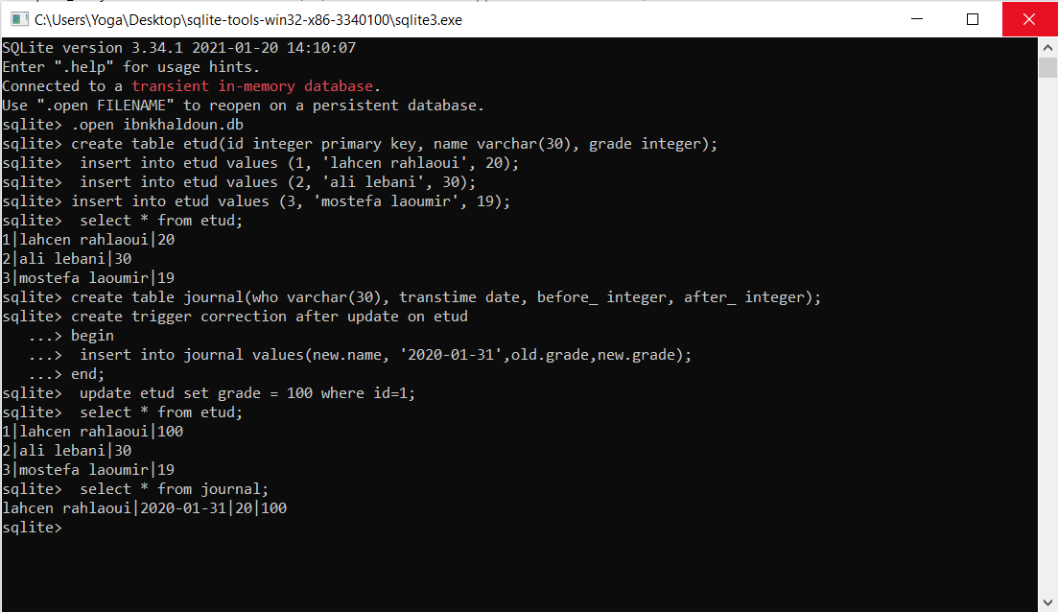
Journalisation with TRIGGERS
Example :
journal saving of a transaction using a trigger.

Slide 66
Importance of DBMS Interfaces
DBMS are just like any software, needs an interface to :
Access and use the various services and features
Check the correct functioning of the system
System maintenance

Slide 67
Utilization of interactive interfaces
Utilization of SQL through command line
Utilization of SQLite tools like « DB Browser for SQLite »

Slide 68
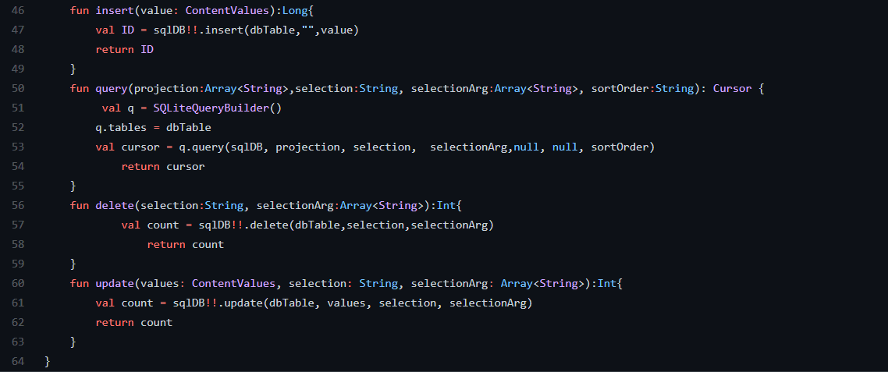
Utilization of a Programmable interface
Which is Using SQLite DBMS through a programming language with SQL
Exemple : Insertion, Delete and Update in table through Kotlin language in Android

Slide 69
Metadata

Slide 70
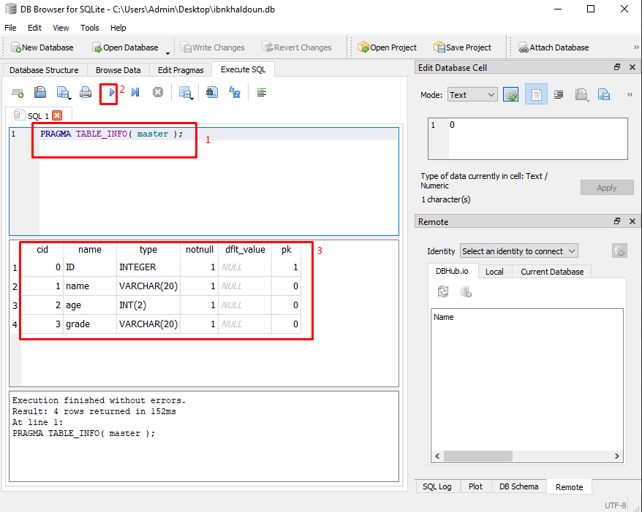
MetaData
Write the query “pragma table_info() ”
Execute the code
The result about the table “master”

Slide 71
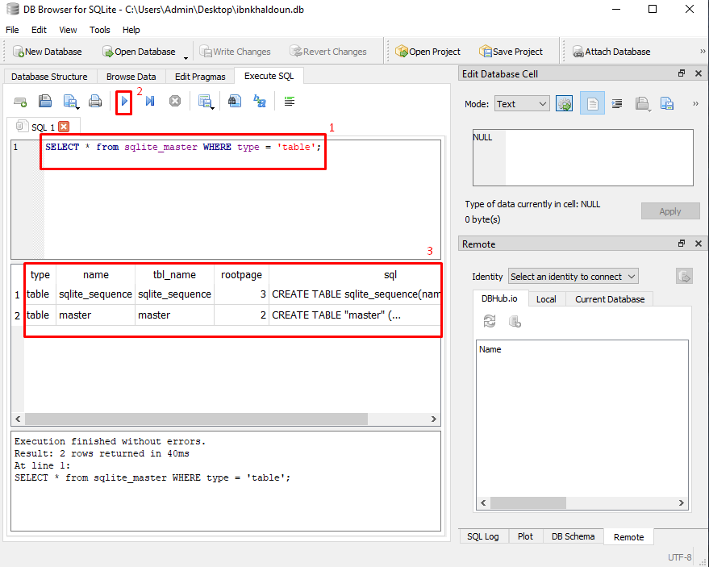
MetaData
Write the query “select * ” types that like table
Execute the code
The result is all the table in the database

Slide 72
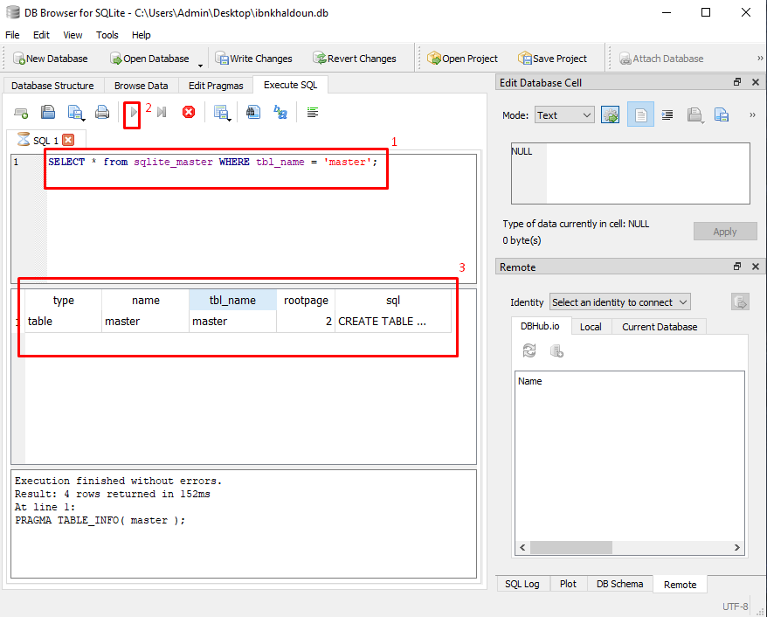
MetaData
Write the query “select *” and specify the table
Execute the code
The result is all tables “master” in the database

Slide 73
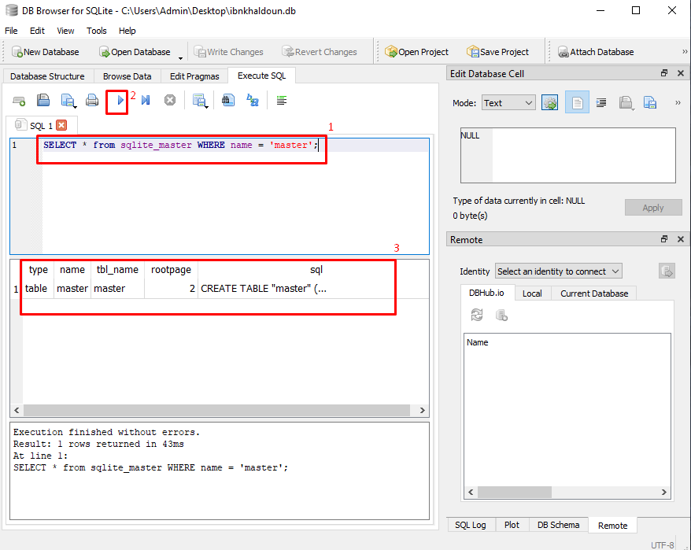
MetaData
The same as the last slide
Write the query “select *” and specify the table
Execute the code
The result is all tables “master” in the database

Slide 74
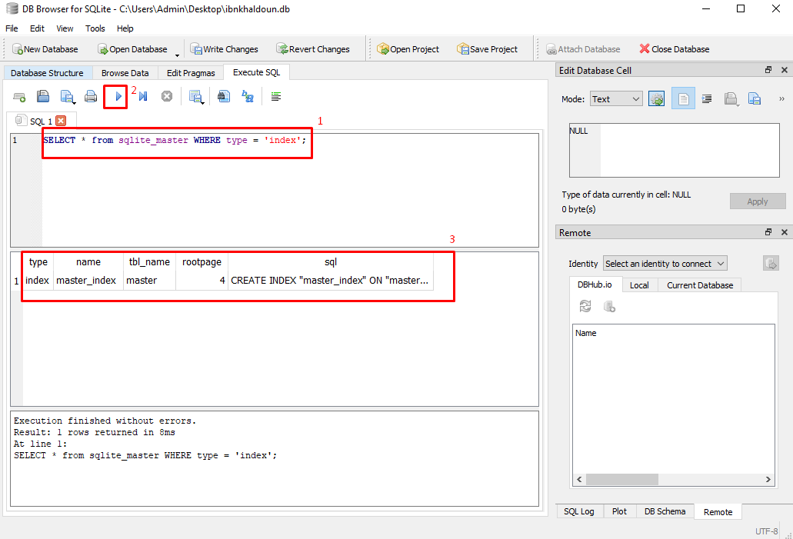
MetaData
Write the query “select *” types index
Execute the code
The result is all the indexes in the database

Slide 75
Security and
Access Permisions

Slide 76
The importance of Security in DBMS
Asserting Confidentiality : protection against data theft and infiltrations
Asserting Data Integrality
Block unauthorized Access

Slide 77
Security
SQLite has no way to defend the database file and overwrite it
the best solution for storing sensitive data in SQLite is to encrypt it before storage.
If you prefer not to encrypt the data yourself, SQLite has an extension called SQLCipher that will perform encryption. the community edition is open source.

Slide 78
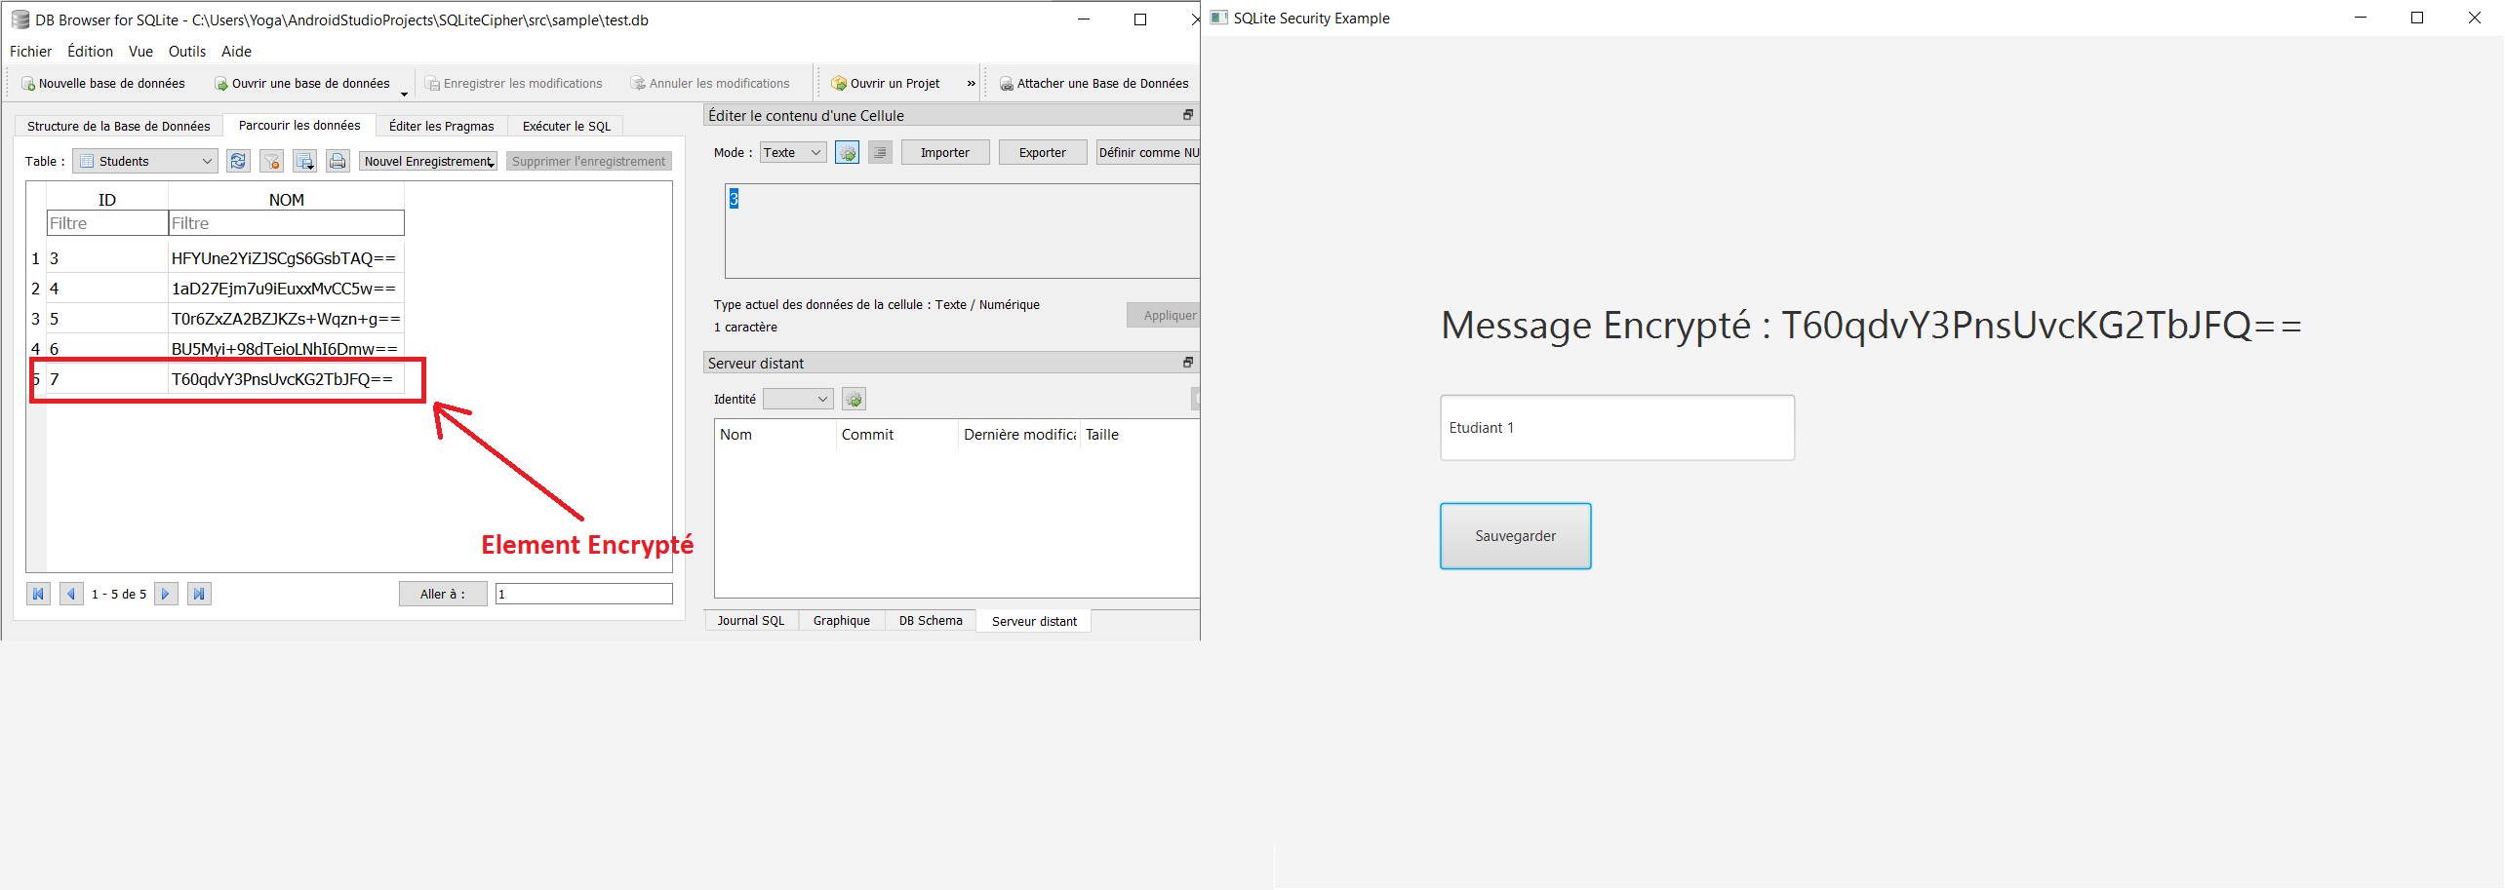
Security
This is an example that we coded to encrypt data before Storing it in the DataBase

Slide 79
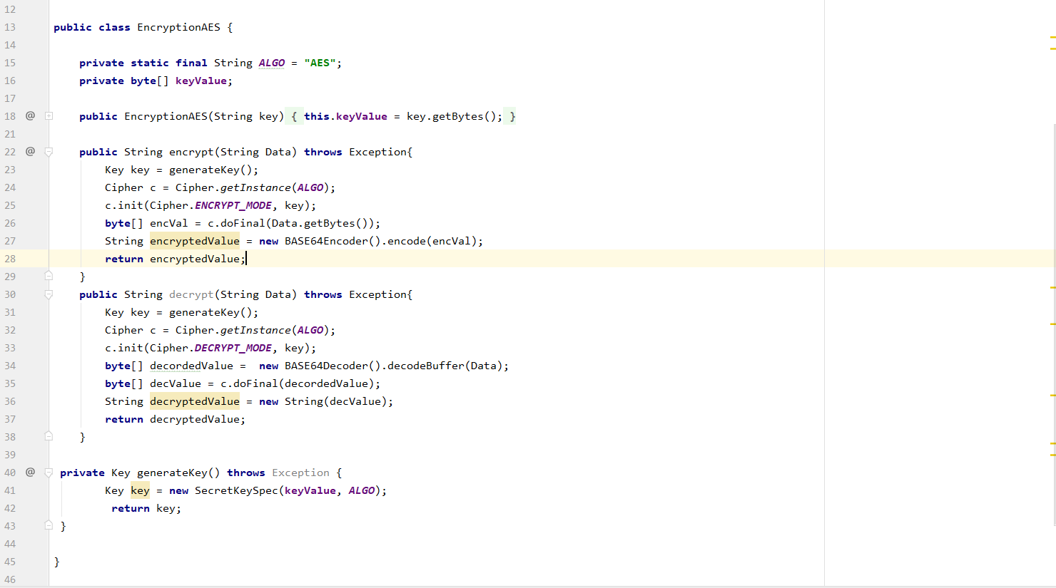
Security
This is the class we coded in Java, We used AES Encryption with 16byte keys

Slide 80
Access Permissions in SQLite
SQLite does not provide a control mechanism to access permissions
The only Access Permission is the one provided by the Operating System

